Slide 1

COVID-19 Modeling in US States Using LSTM Neural Networks
By Josh McGuckin, Neil Patel, Daniel Gallagher, Robert Saporito

Slide 2
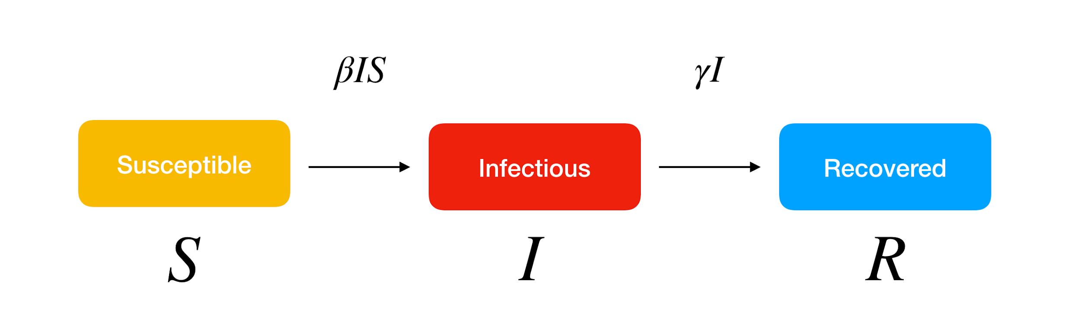
SIR Epidemiology Model

Slide 3
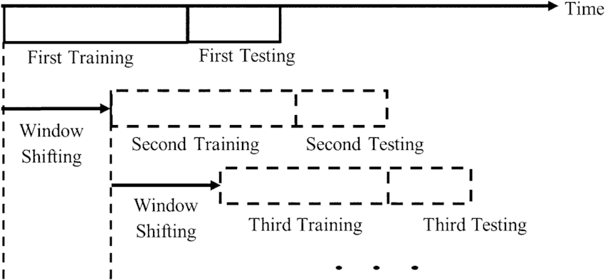

Slide 4
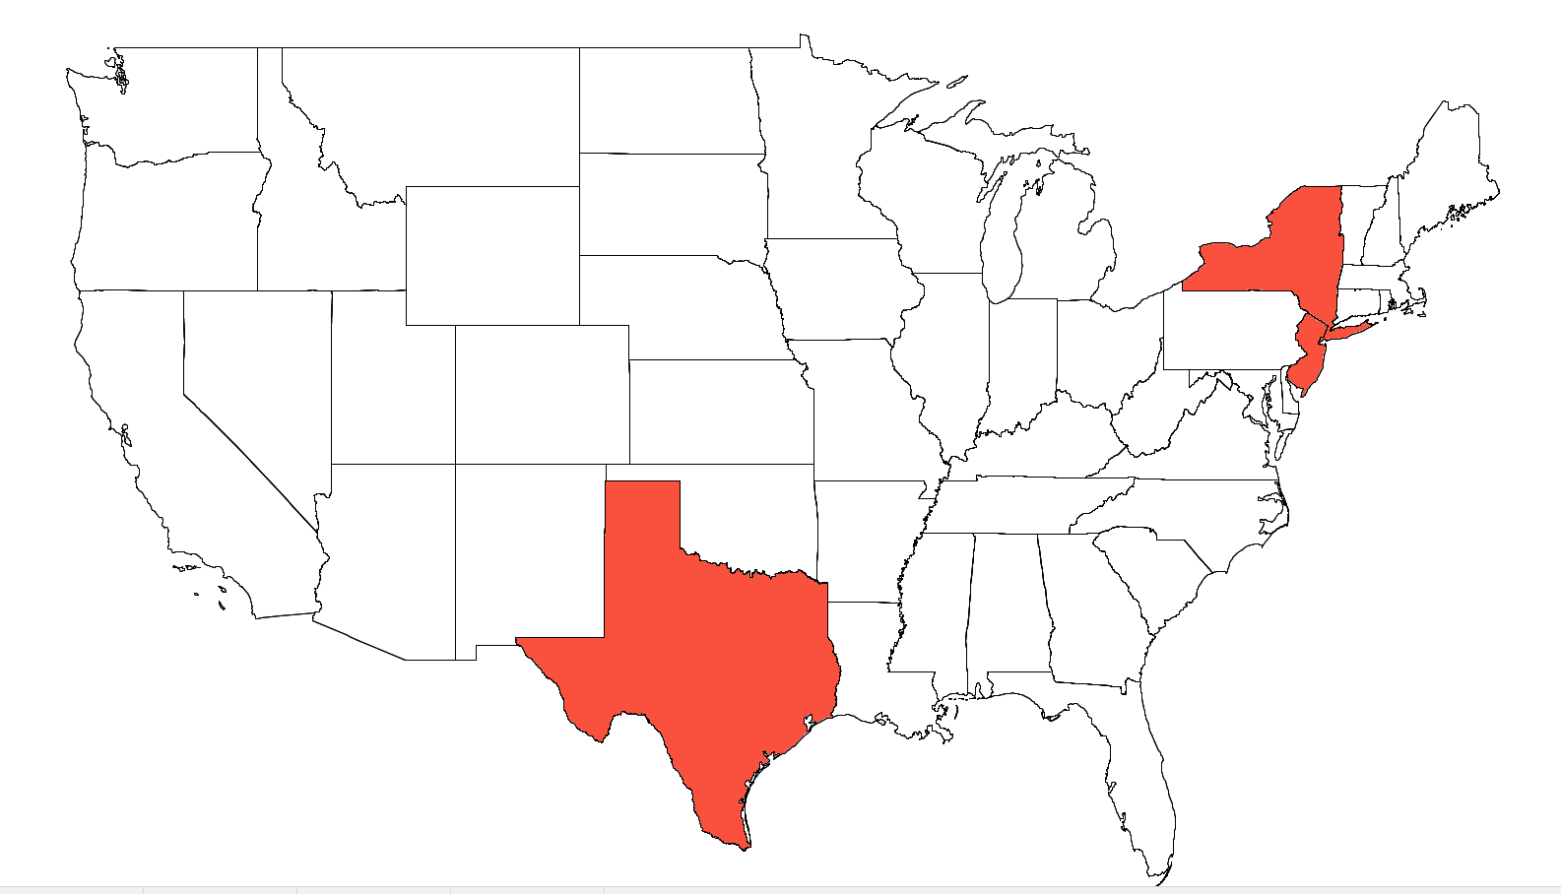
Target States

Slide 5
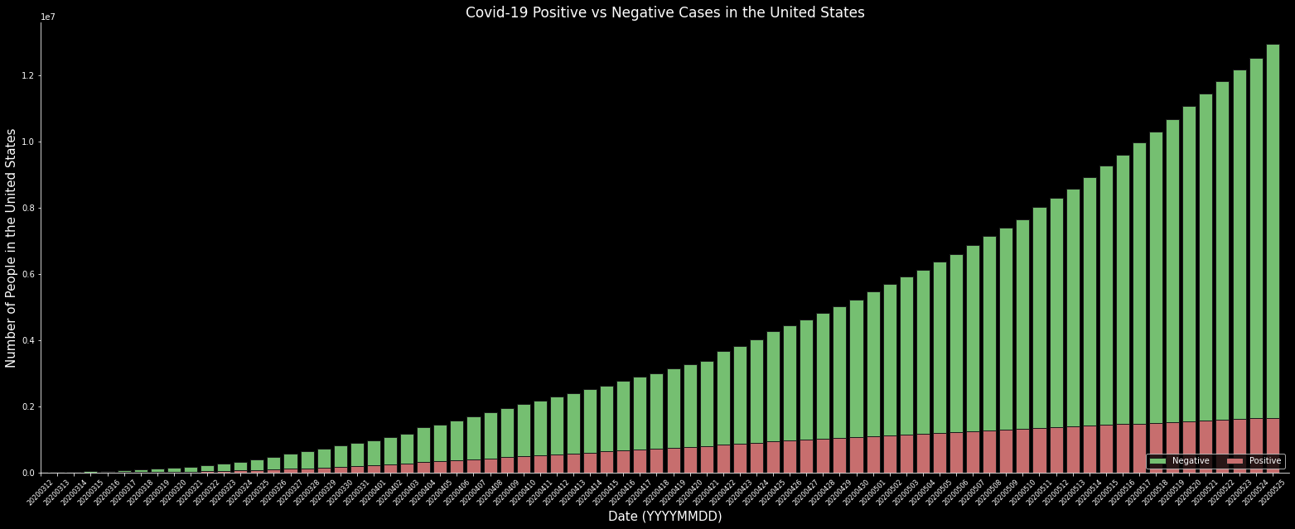
US State Shutdown Timeline
TX Shutdown
NY/NJ Shutdown

Slide 6
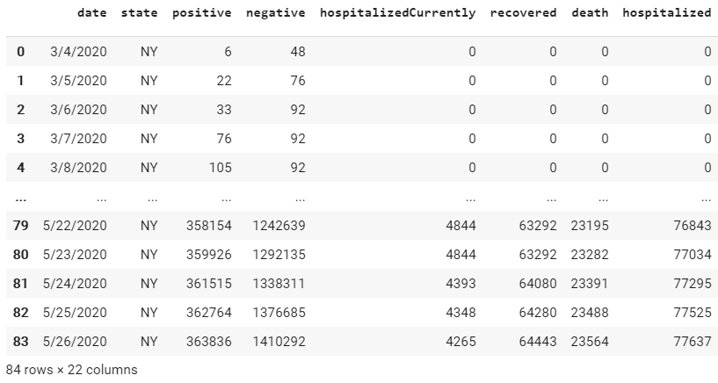
Our Datasets
Johns Hopkins
  Epidemiological dataset
Google + Apple
  Intra-State Mobility
Goal → QIRT
  Quarantined pop. (t)
    hospitalized
  Infected (t)
  Recovered (t)
  Transportation (t)

Slide 7
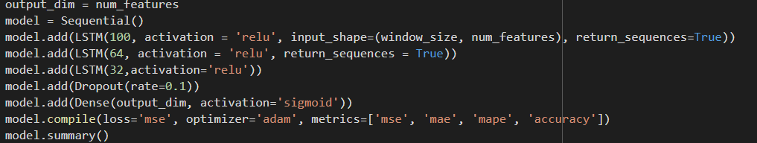
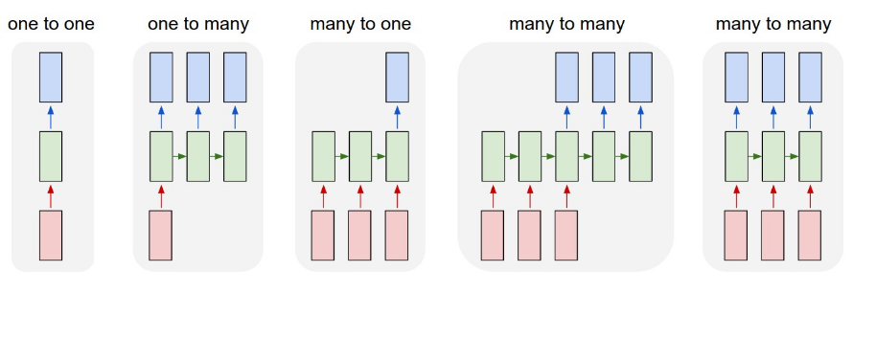
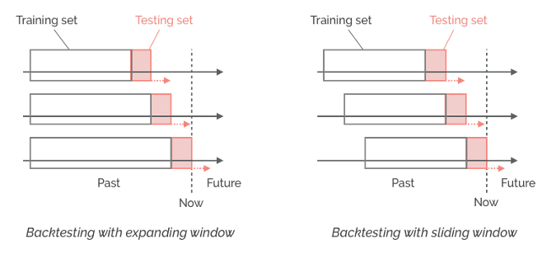
QIRT LSTM Model Architecture

Slide 8
QIRT LSTM Model Architecture
Input Layer
Normalized (18)
Hidden Layer 1 LSTM (100)
Hidden Layer 2 LSTM (64)
Hidden Layer 3 LSTM (32)
Output Layer Sigmoid (18)
Pos(t)
Neg(t)
Pos(t+window)
...
Neg(t+window)
...
...
...
...
Mobility(t+window)
...
Mobility(t)
Train = (t-window)
Test = (t)
Forecast = (t+window)

Slide 9
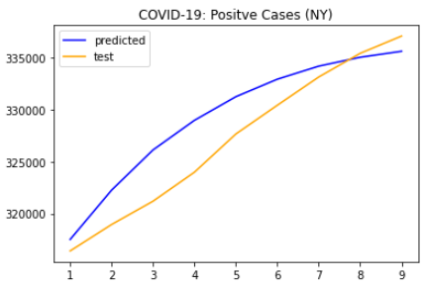
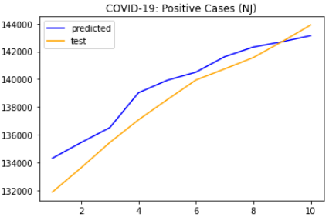
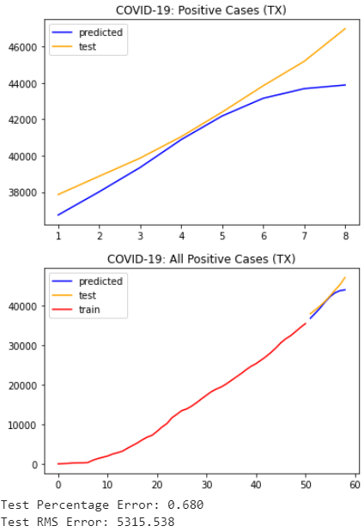
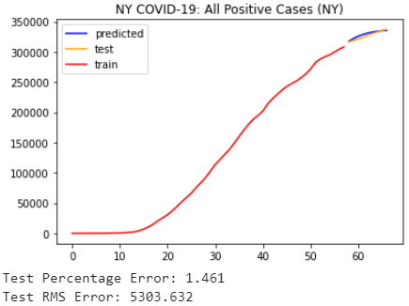
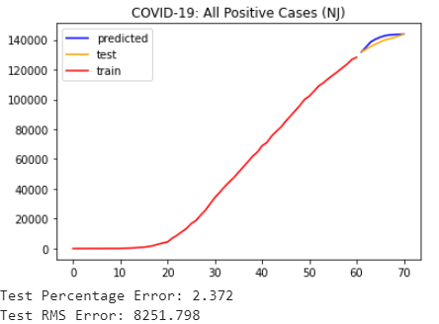
Model Eval: COVID-19 Positive Cases
v

Slide 10
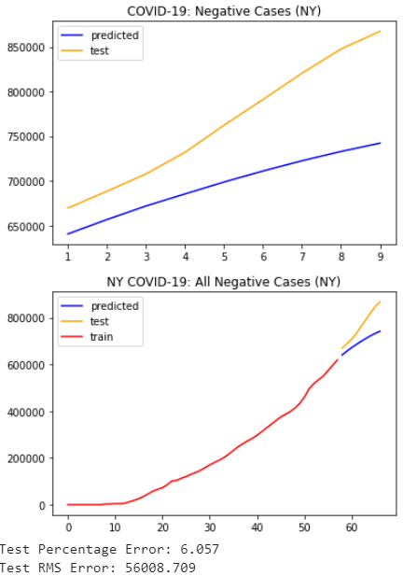
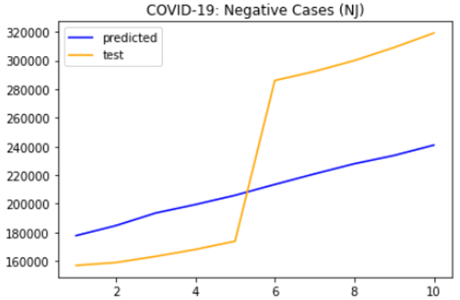
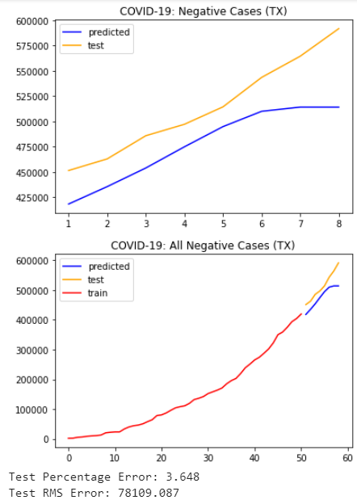
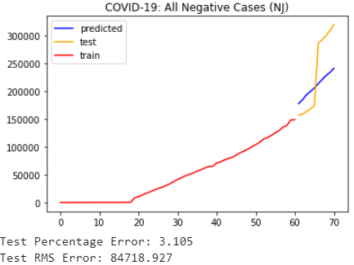
Model Eval: COVID-19 Negative Cases

Slide 11
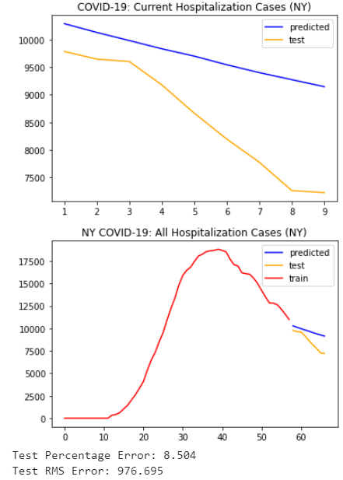
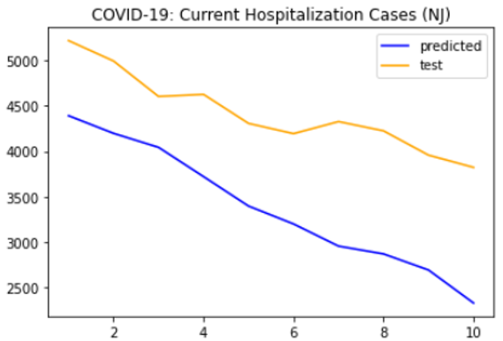
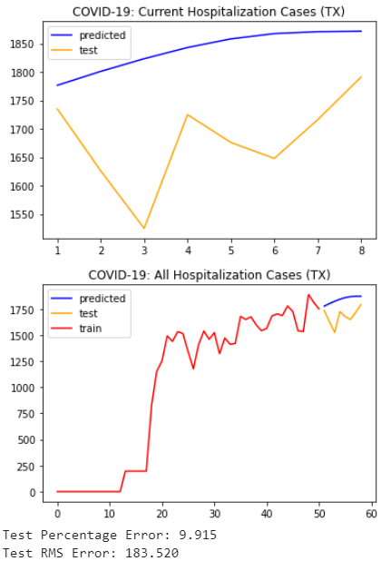
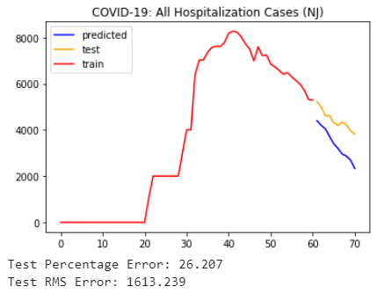
Model Eval: COVID-19 Hospitalizations

Slide 12
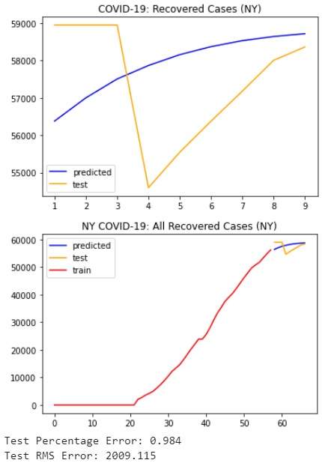
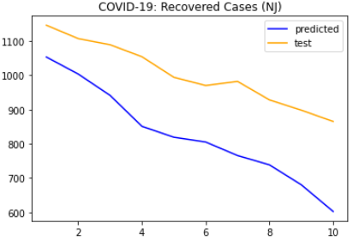
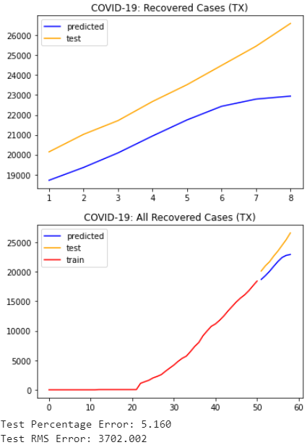
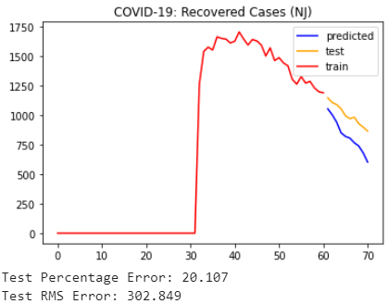
Model Eval: COVID-19 Recovered Cases

Slide 13
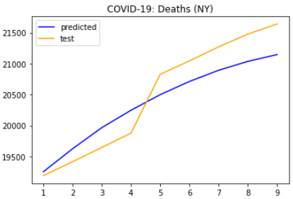
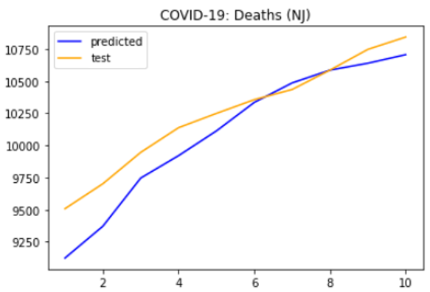
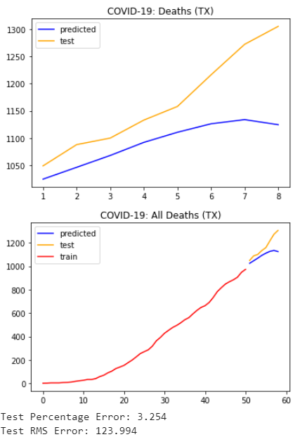
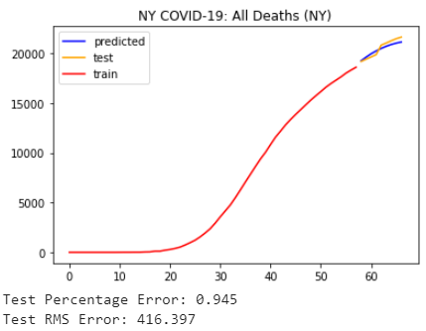
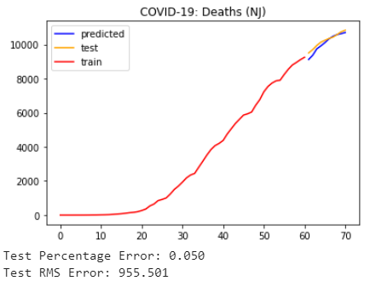
Model Eval: COVID-19 Deaths

Slide 14
Forecasting - Algorithm
Scale (0,1)
2D Data (0-1): N rows
Must become compatible (window_size = #days)
  Based on dataset size
Reshape: 2D → 3D [1 (window), #days, #parameters]
2D Data: N rows
3D Data (0-1): N rows
Dataset
[row, col] = [day, parameter]
Fit Model (state)
3D Data (0-1): 1 row
Reshape: 3D → 2D [row, col] = [day, parameter]
2D Data (0-1): 1 row
Inv Scale
2D Data: 1 row
Add to bottom, remove top
2D Data: N rows (shifted ↓ 1)

Slide 15
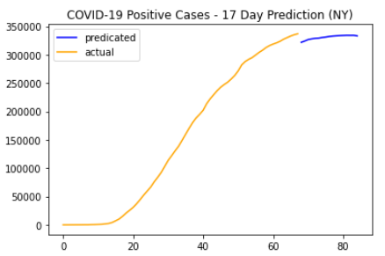
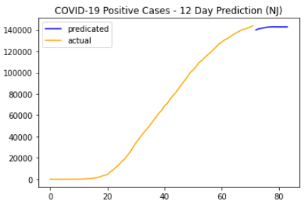
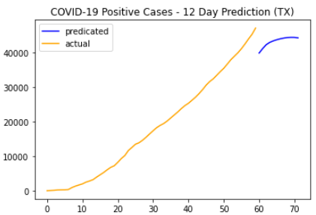
Predictions - Positive Cases

Slide 16
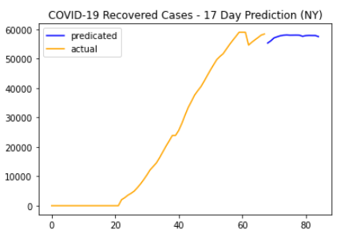
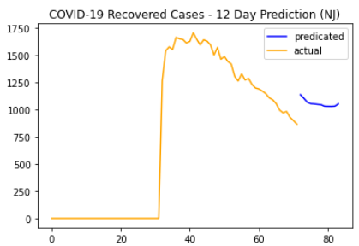
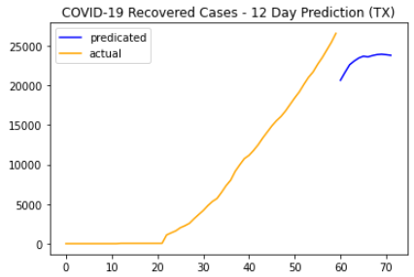
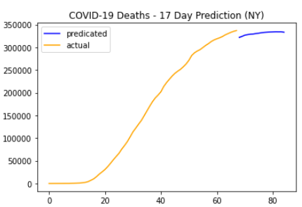
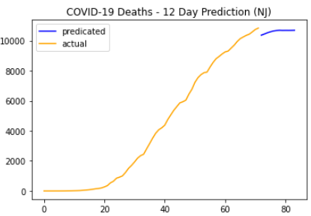
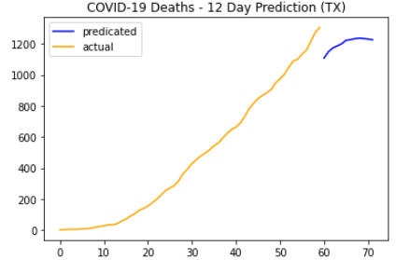
Predictions - Recovered & Deaths

Slide 17
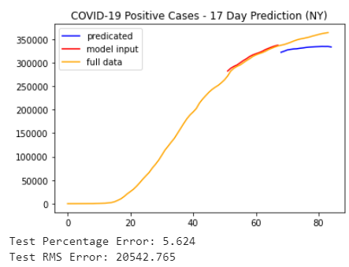
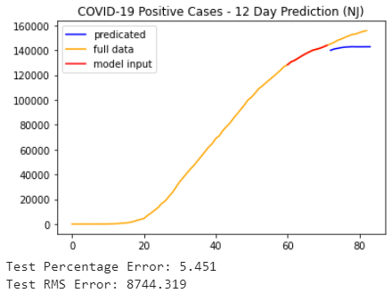
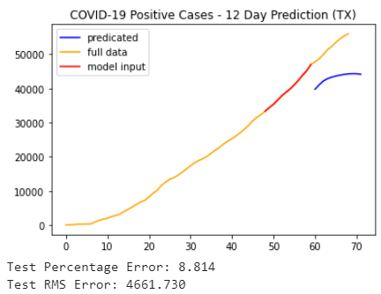
Prediction Eval - Positive Cases

Slide 18
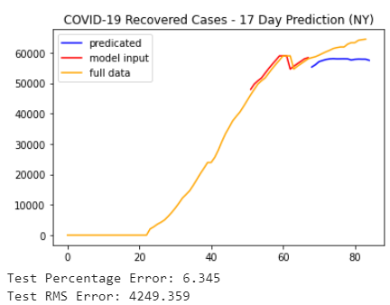
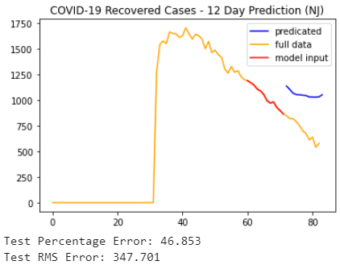
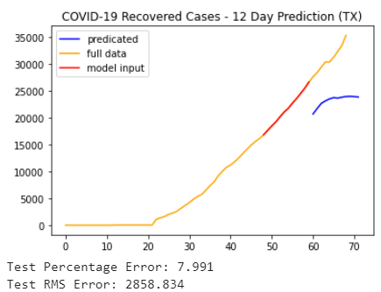
Prediction Eval - Recovered Cases

Slide 19
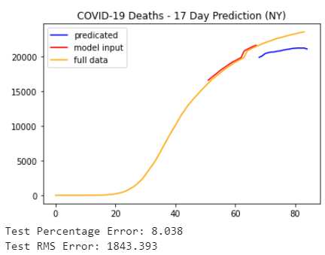
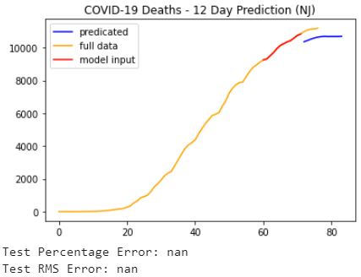
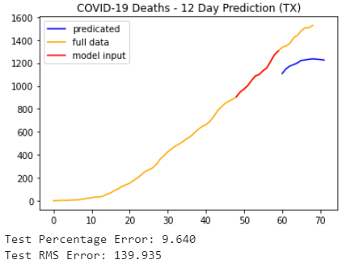
Prediction Eval - Deaths

Slide 20
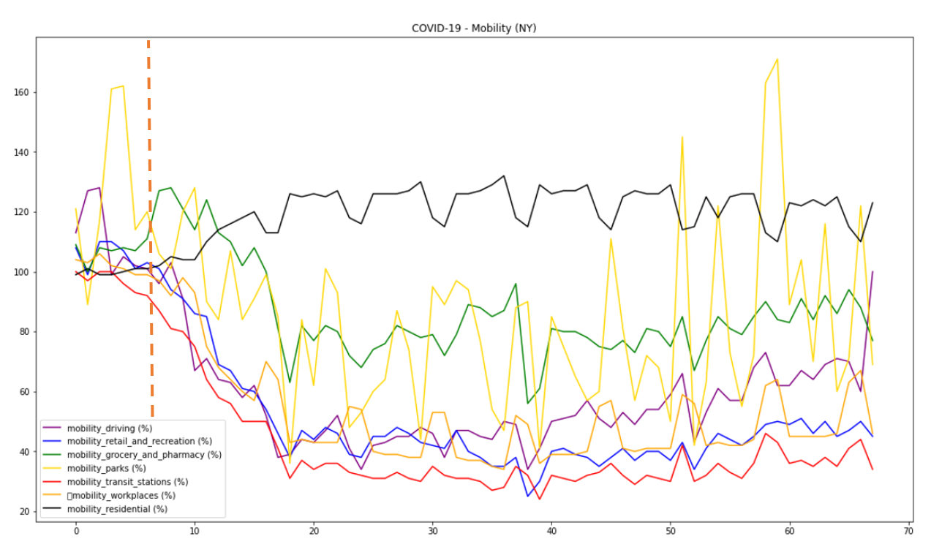
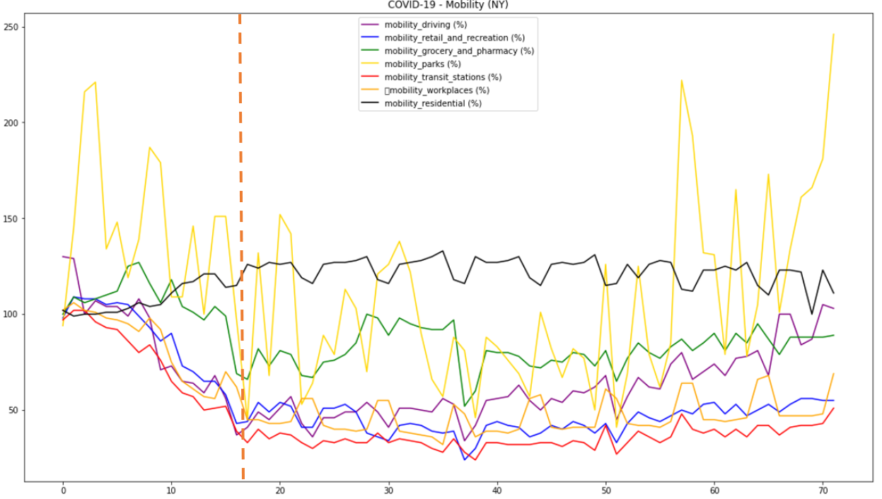

Intra-state Mobility
Comparisons

Slide 21
Target States

Slide 22

Possible Improvements
Hyperparameter optimization
  What do we need vs what don’t we need
  More features???
More States (Meta analysis)
  Individual states vs. US average
More accurate long term forecasting
  Model has to be trained with enough “good” data
  Need VERY accurate short term forecasts (window size)
    Tested by test data (unseen by model)
  Adding perturbations to make predictions in response to change
    RIOTS??? (Possible change in mobility)
Get rid of earlier, sparse data
  Zeros cause unwanted disruption of trends
    Distort actual data and model output
Comparison with other models
  Linear regression
  Lasso Linear Regression
  Ridge Regression
  GRU RNN

Slide 23
Sources
Johns Hopkins Dataset;
COVID19Tracking. (2020, June 02). COVID19Tracking/covid-tracking-data. Retrieved June 03, 2020, from https://github.com/COVID19Tracking/covid-tracking-data
Google Sponsored Open COVID-19 Dataset:
Open-covid-19. (2020, June 02). Open-covid-19/data. Retrieved June 03, 2020, from https://github.com/open-covid-19/data
Elflein, J. (2020, May 29). U.S. COVID-19 cases by state. Retrieved June 03, 2020, from https://www.statista.com/statistics/1102807/coronavirus-covid19-cases-number-us-americans-by-state/

